Slide 1
PROJECT REPORT FUNDAMENTALS 1
Subject: Project Fundamentals 1 (IT)
Name: Tran Thi Ngoc Mai
Class : 24IT6
Supervisor : Mr. Dang Dai Tho.

Slide 2
1. Introduction to the topic
3. System analysis and design
2. Theoretical basis
4. Conclusion

Slide 3
Introduction to the topic
01

Slide 4
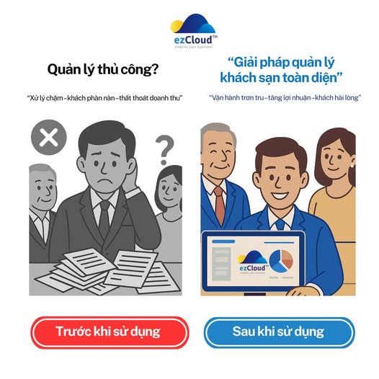
Reasons for Choosing the Topic
- Manual hotel management leads to losses and is time-consuming
- There is a growing demand for digitizing management processes.
Significance
- To help simplify operations for hotel staff.
- This is an initial step towards understanding and building a professional management system. .

Slide 5

Project Objectives Original
Reduce manual tasks, limit errors, and improve work efficiency.
Provide a professional experience for customers.
Support managers in statistics, reporting, and making quick decisions.
User-friendly and easy-to-use interface.

Slide 6
THEORETICAL BASIS
02

Slide 7
Technologies Used
Java Swing | Provides various interface components like buttons, tables, menus, etc. Supports event handling, flexible layouts, and interface customization.
My SQL | Supports table relationship management, user authorization, and ensures data security.
Socket | ServerSocket is used to listen for connections. Socket is used to exchange data. Supports both TCP (reliable) and UDP (fast, order not guaranteed).
TCP/IP | TCP ensures stable and reliable connections. IP routes and identifies device addresses.
Json &XML | JSON: Lightweight, easy to read, commonly used in web APIs. XML: Clear structure, easily extensible, used for storing structured data.

Slide 8
SYSTEM ANALYSIS AND DESIGN
03

Slide 9
System Actors
Customer | Receptionist
Register, log in, and reset password via email. Book rooms and select services online. Look up room information by status. | Receive and process bookings. Update room status. Calculate bills and issue invoices. View reports, revenue statistics.

Slide 10
Functions
Customer Functions
Register, Log In, and Update Password
- Users can create new accounts and log in with a username and password.
- Supports password reset via OTP email verification when forgotten.
Room Status
- The interface displays a visual room map with colors indicating status: Available – White, Booked – Purple, Pending Confirmation – Pink.
Book Room & Select Services.
- Customers can choose rooms according to their needs and add extra services such as dining, transportation, laundry, etc., directly on the system.

Slide 11
Functions
Admin Functions (Staff & Management)
Room Map Management:
Track room status (Available, Booked, Pending Confirmation) for quick coordination.
Receive Bookings & Services:
Receive booking information, manage services used by guests.
Calculate Costs & Issue Invoices:
Automatically calculate the total amount and print invoices based on length of stay and services.
Statistics & Reports:
Export revenue reports and booking history as XML files.

Slide 12
CONCLUSION
04

Slide 13

The project successfully developed a hotel management application with basic functions such as booking, service management, and invoicing.
The product demonstrates the ability to apply knowledge to practice, aiming to optimize management processes for small-scale hotels.
In the future, the system can be expanded with online payment and a mobile platform interface.

Slide 14
THANK YOU

